Slide 1
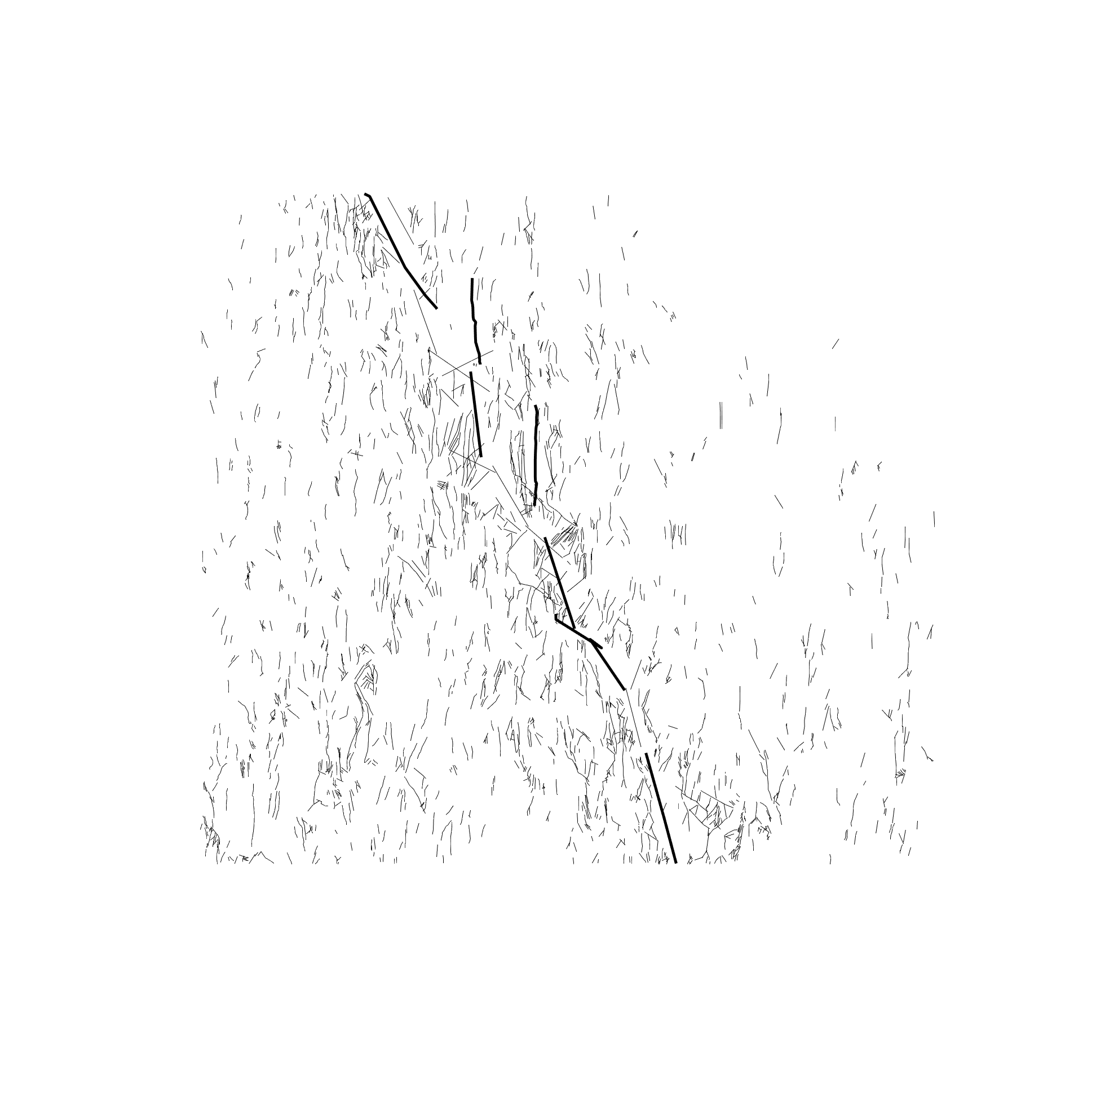
Fractures_H12Z.txt
60% max length = 5 pt line, rest = 0.5 pt line; image is 1944 pixels square, at 72 DPI
a = 4, 8, 16, 24 as per GRL paper (and L = 1/a), delta theta = 10 degrees; Morlet wavelet

Slide 2
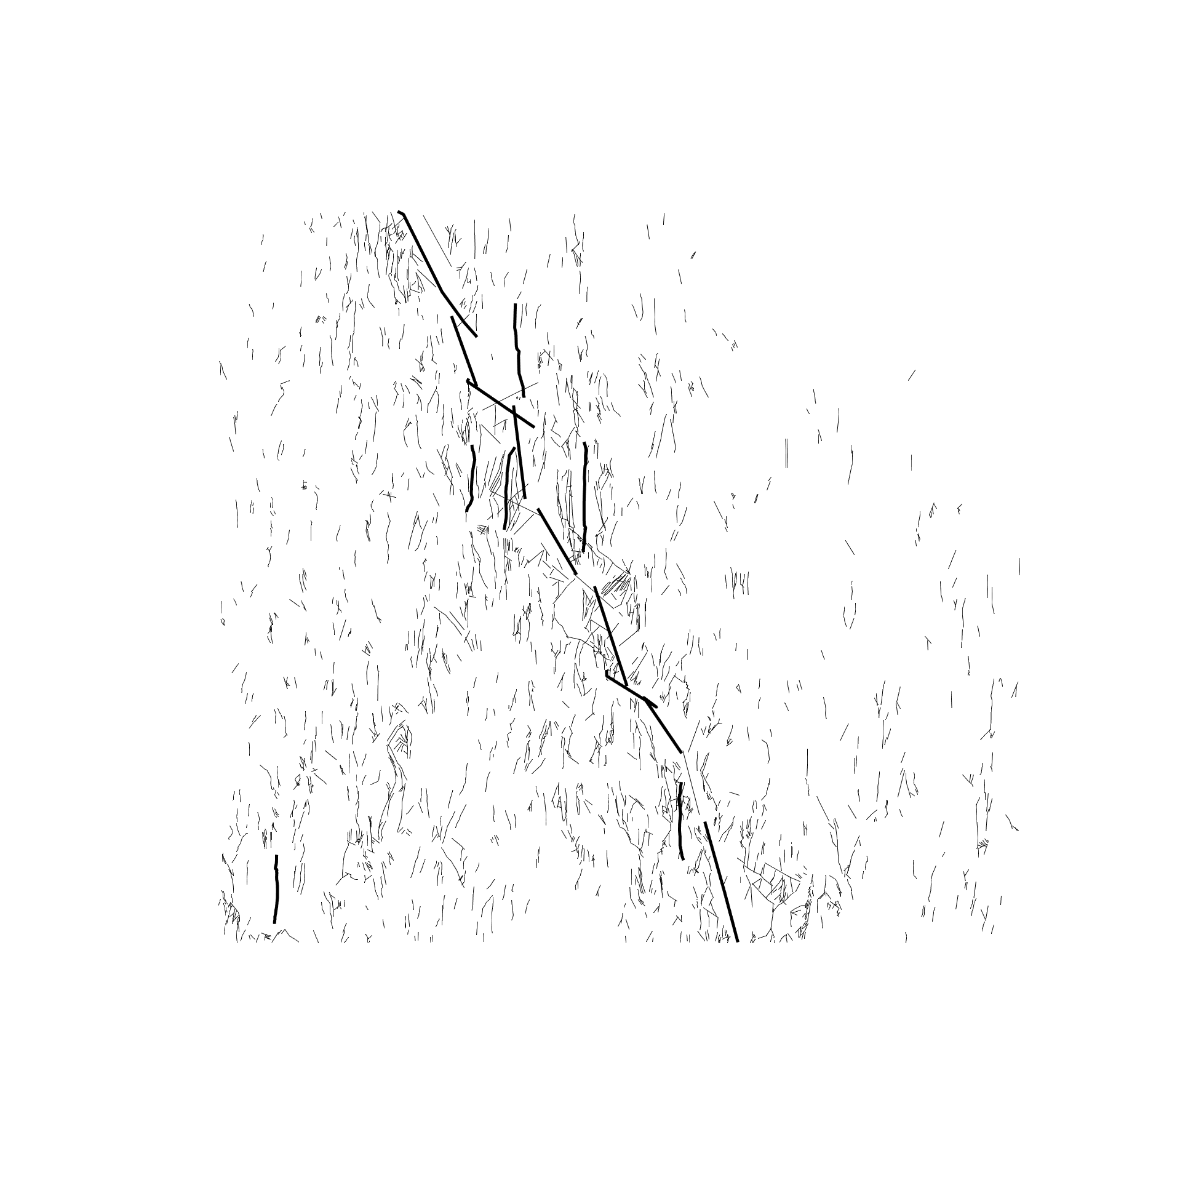
Fractures_H12Z.txt
45% max length = 5 pt line, rest = 0.5 pt line; image is 1944 pixels square, at 72 DPI
a = 4, 8, 16, 24 as per GRL paper (and L = 1/a), delta theta = 10 degrees; Morlet wavelet

Slide 3
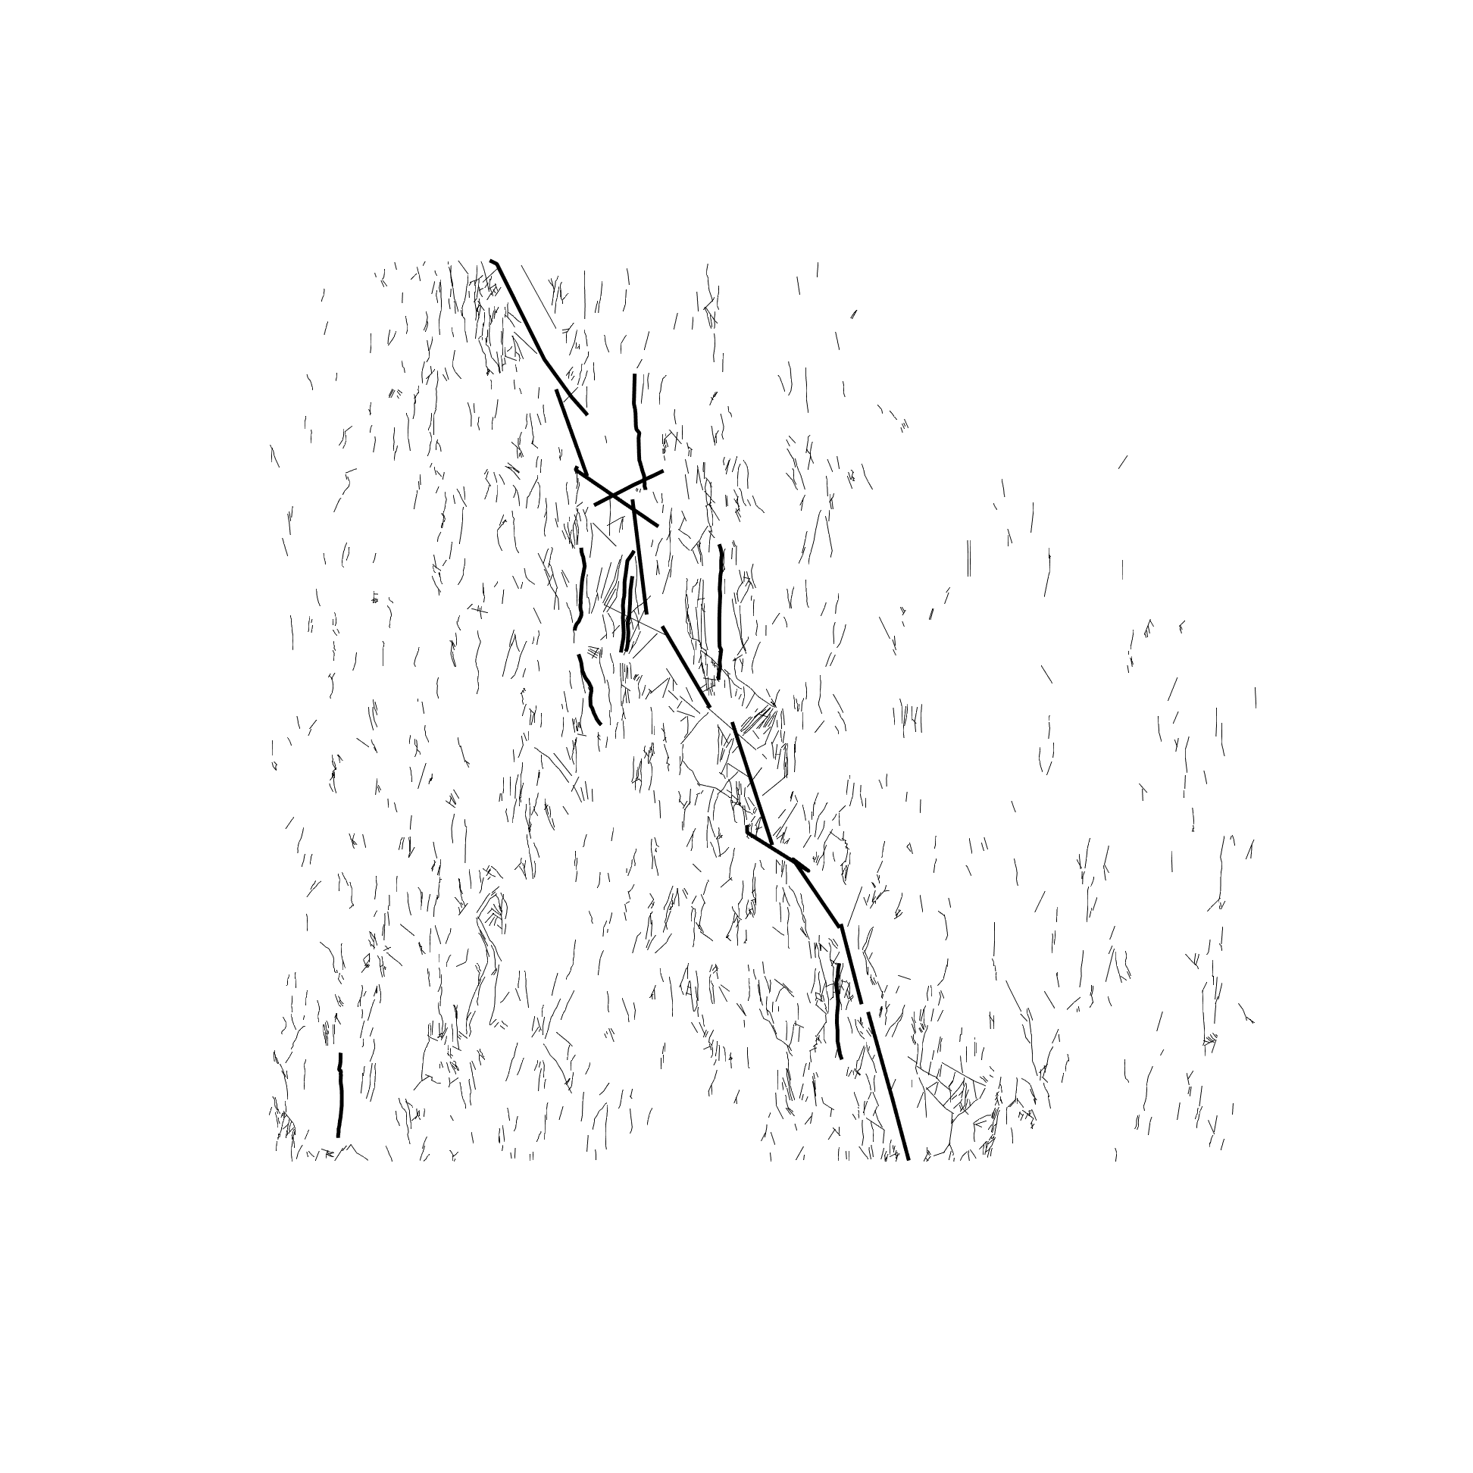
Fractures_H12Z.txt
40% max length = 5 pt line, rest = 0.5 pt line; image is 1944 pixels square, at 72 DPI
a = 4, 8, 16, 24 as per GRL paper (and L = 1/a), delta theta = 10 degrees; Morlet wavelet

Slide 4
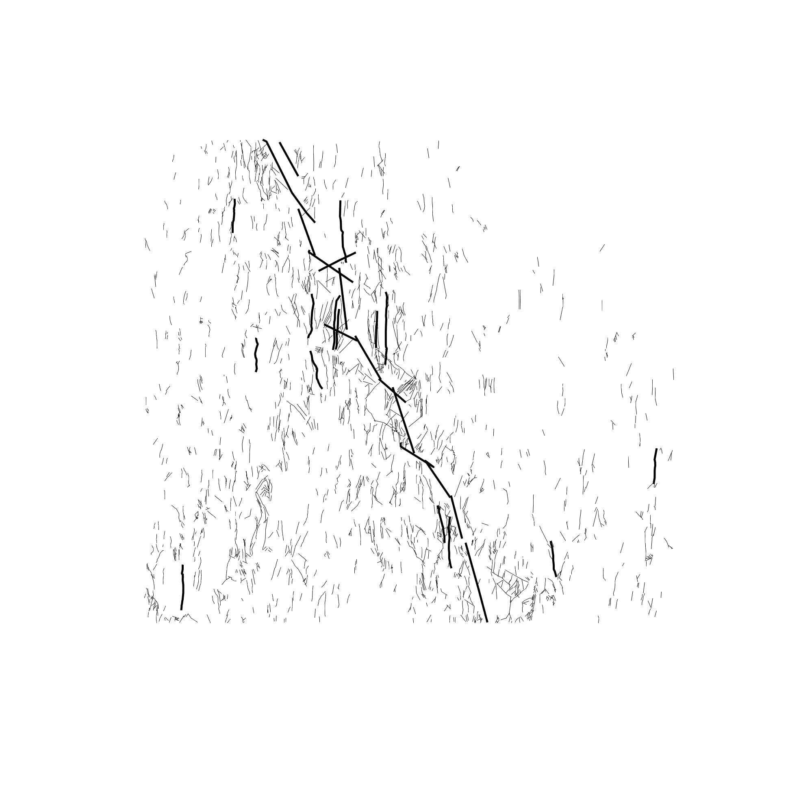
Fractures_H12Z.txt
35% max length = 5 pt line, rest = 0.5 pt line; image is 1944 pixels square, at 72 DPI
a = 4, 8, 16, 24 as per GRL paper (and L = 1/a), delta theta = 10 degrees; Morlet wavelet

Slide 5
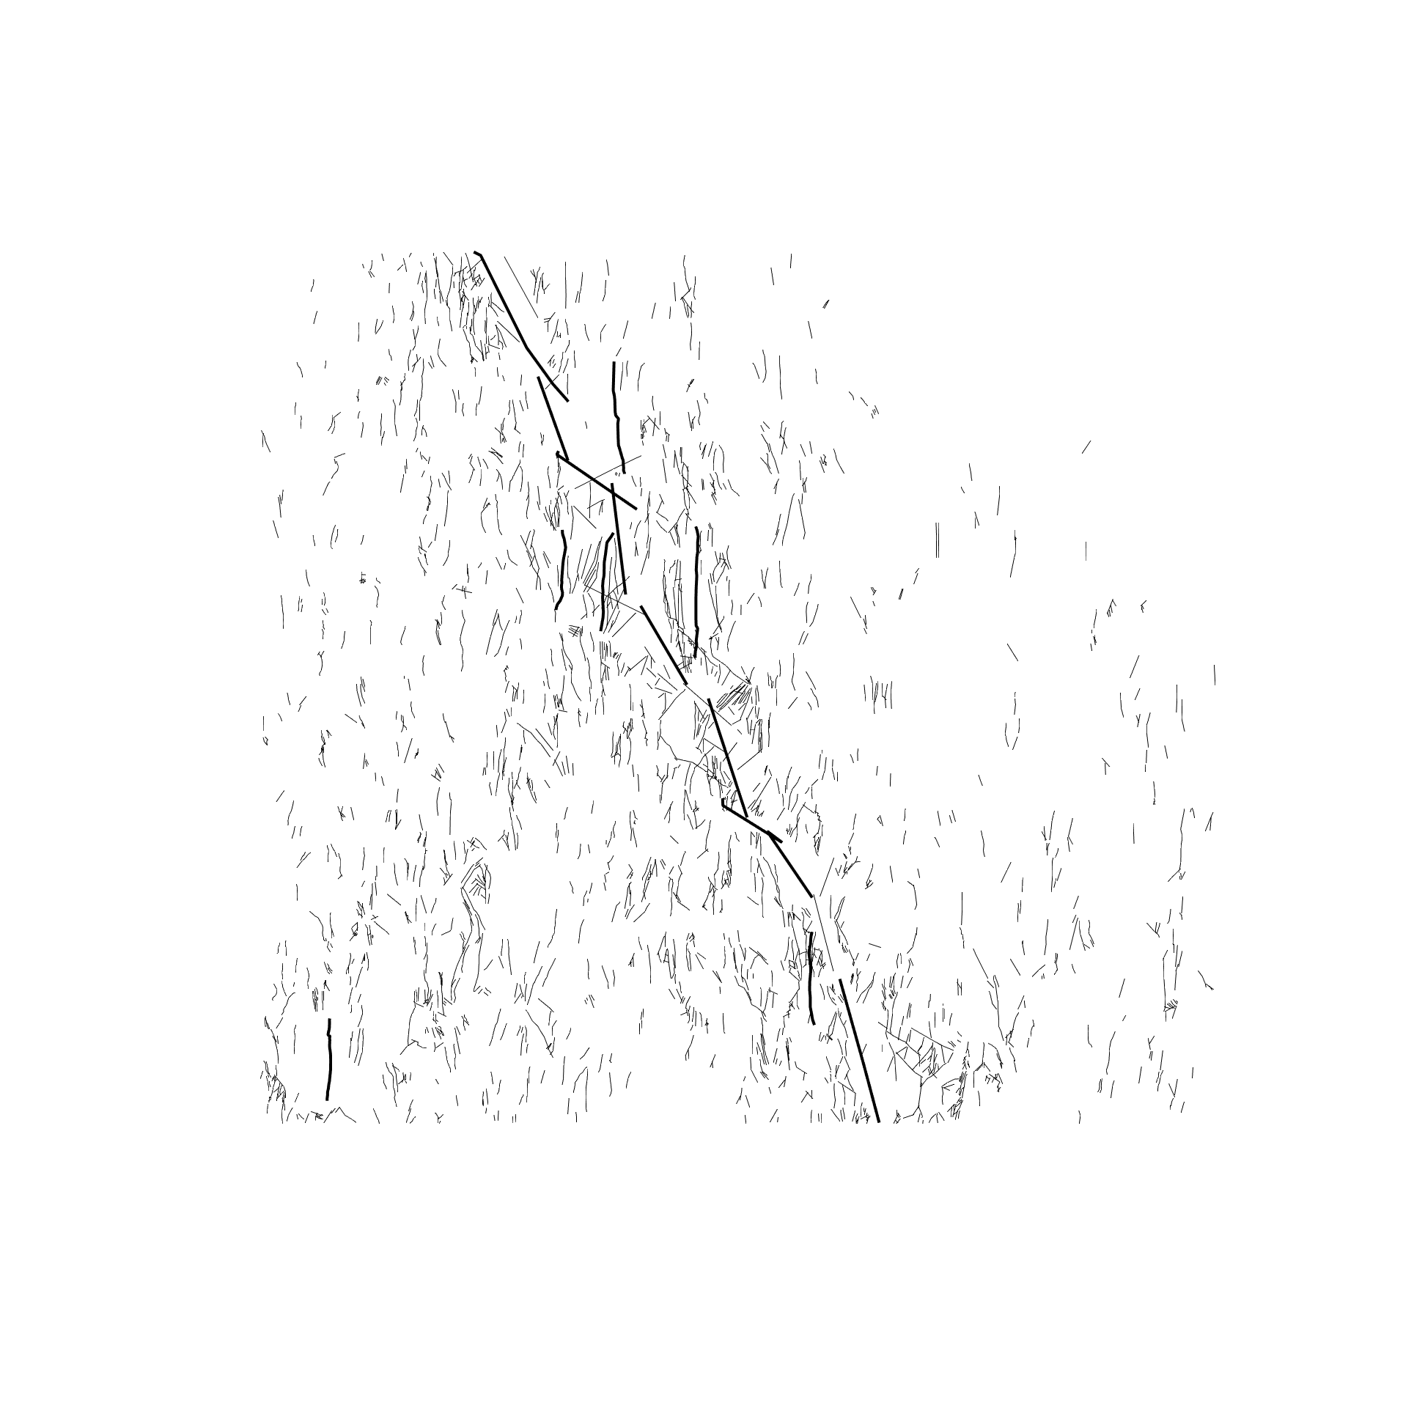
Fractures_H12Z.txt
45% max length = 4 pt line, rest = 1 pt line; image is 1944 pixels square, at 72 DPI
a = 4, 8, 16, 24 as per GRL paper (and L = 1/a), delta theta = 10 degrees; Morlet wavelet

